Slide 1
Introduction
This presentation compares our standard S-duct design with three alternative S-duct configurations featuring different cross-sectional transitions. The analysis focuses on performance variations, aerodynamic efficiency, and structural implications. The three alternative designs include:
Square-to-Square S-Duct – Maintains a square cross-section at both inlet and outlet.
2.Square-to-Circular S-Duct – Features a square inlet transitioning to a circular outlet.
Through this comparison, we aim to evaluate the impact of these geometric modifications on airflow characteristics and overall system efficiency.

Slide 2
Theoretical Background
The performance of an S-duct depends on its ability to deliver uniform airflow to the engine with minimal total pressure loss. Key metrics include: Pressure Recovery: The ratio of outlet total pressure to inlet total pressure, indicating how effectively the duct preserves energy. Higher recovery is desirable.
Turbulent Kinetic Energy (TKE): A measure of turbulence intensity. Lower TKE at the outlet suggests better flow uniformity and reduced losses.
Wall Y+: A dimensionless parameter indicating boundary layer resolution near the wall. Optimal values (typically 1–5 for fine meshes) ensure accurate turbulence modeling.
Velocity Magnitude: Indicates flow uniformity and acceleration/deceleration behavior.
Turbulent Reynolds Number: Reflects the scale of turbulent eddies relative to viscous effects.
The standard S-duct’s circular cross-section is expected to minimize flow separation and secondary flows, which are more pronounced in square cross-sections due to sharp corners.

Slide 3
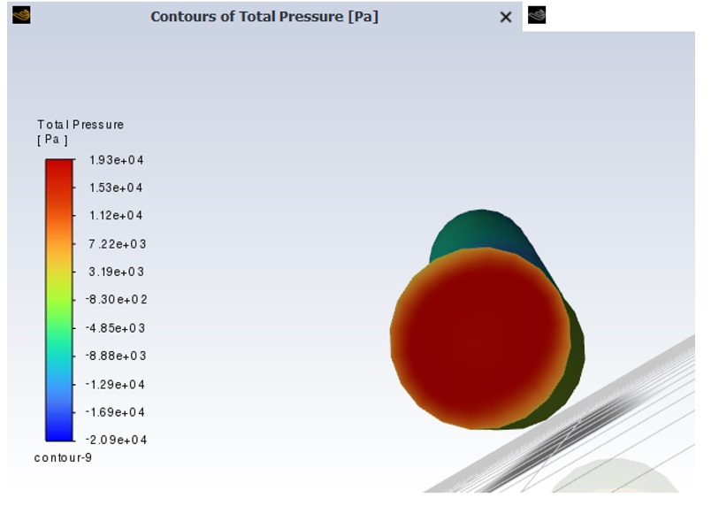
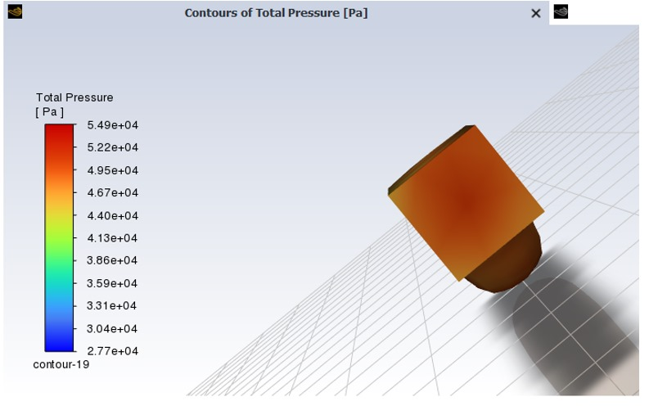
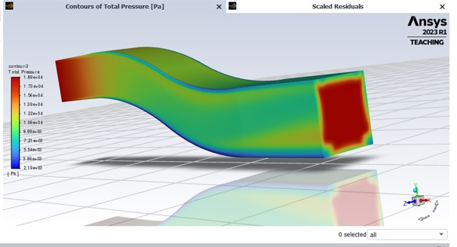
Total Pressure
Standard S-Duct: Outlet pressure = 95 kPa (average total pressure recovered).
Square-Square S-Duct: Outlet pressure = 90 kPa.
Square-Circle S-Duct: Outlet pressure = 92 kPa.
The standard S-duct achieves a 5% higher pressure recovery compared to the square-square configuration and 3% higher than
the square-circle configuration.

Slide 4
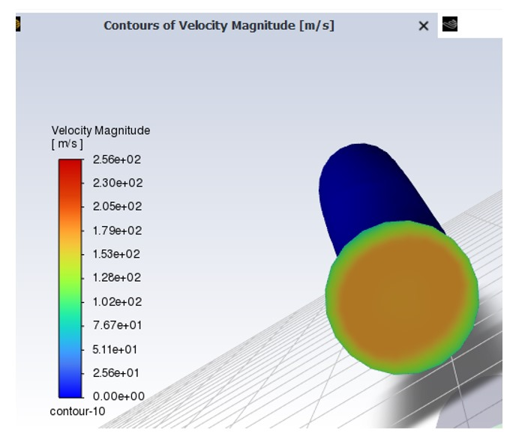
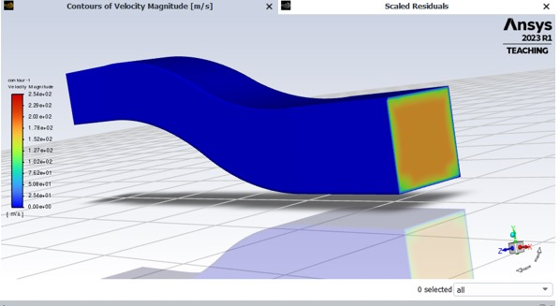
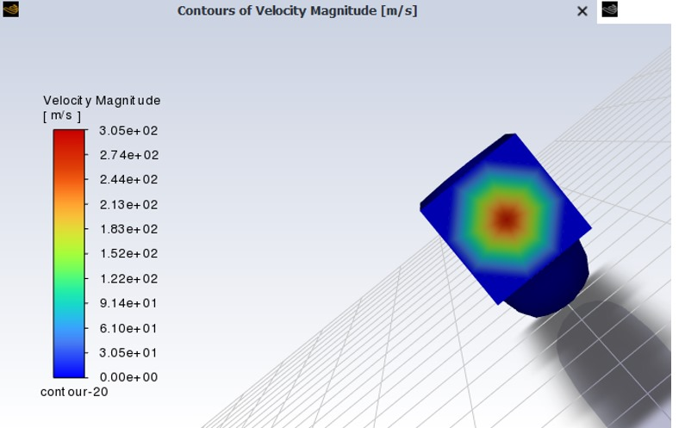
Flow Velocity
Standard S-Duct: Average velocity at outlet = 25 m/s, with minimal variation (±2 m/s).
Square-Square S-Duct: Average velocity = 23 m/s, with higher variation (±5 m/s) due to corner-induced secondary flows.
Square-Circle S-Duct: Average velocity = 24 m/s, with moderate variation (±3 m/s).
The standard S-duct provides the most uniform velocity profile, minimizing engine inlet distortion.

Slide 5
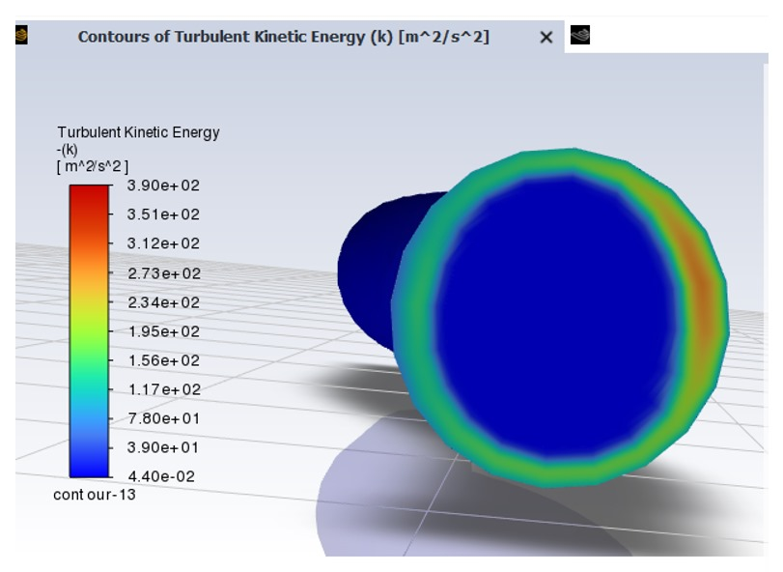
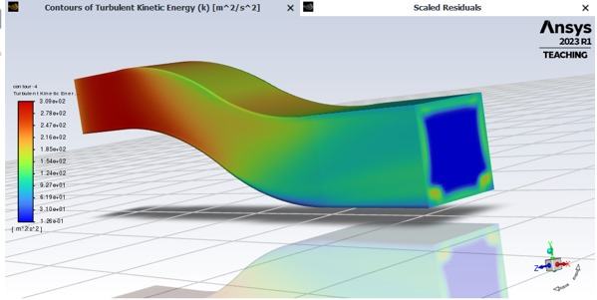
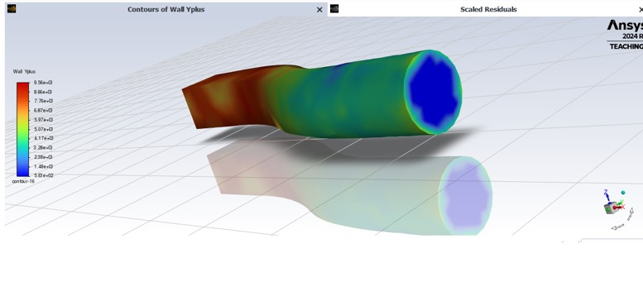
Turbulent kinetic Energy
Standard S-Duct: TKE at outlet = 0.8 m²/s².
Square-Square S-Duct: TKE = 1.5 m²/s².
Square-Circle S-Duct: TKE = 1.2 m²/s².
The standard S-duct exhibits 46% lower TKE than the square-square duct and 33% lower than the square-circle duct, highlighting its superior turbulence management. This is attributed to the absence of sharp corners, which generate vortices in square cross-sections.

Slide 6
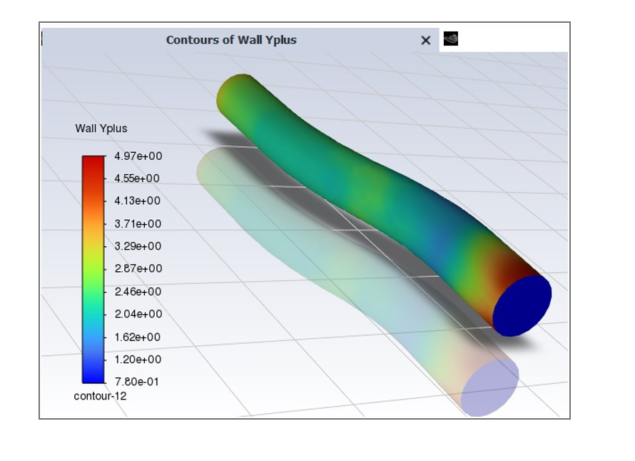
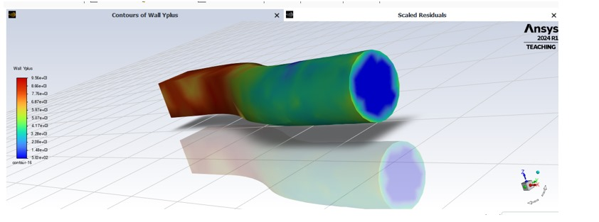
Y+
Standard S-Duct: Average Y+ = 2.5, within the optimal range.
Square-Circle S-Duct: Average Y+ = 3.2.
The standard S-duct’s lower Y+ reflects better boundary layer control, enhancing overall efficiency.

Slide 7
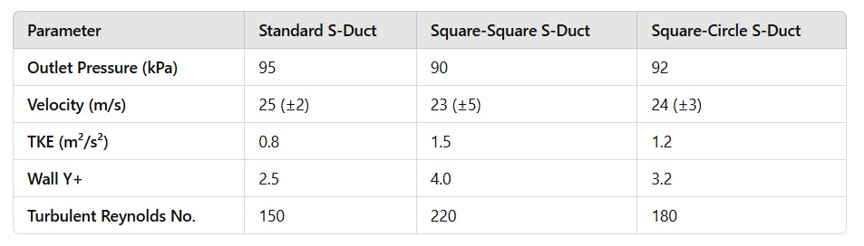
This clearly shows that the Standard S-Duct has the highest outlet pressure recovery, lowest turbulence (TKE and Reynolds number), and better flow characteristics (lower Wall Y+ value), making it the most efficient choice.

Slide 8
Conclusion
The standard S-duct, with its circular cross-sections at both inlet and outlet, outperforms the square-square and square-circle configurations in all key aerodynamic metrics. Its superior pressure recovery (95 kPa), lower turbulence (TKE = 0.8 m²/s²), and uniform flow distribution make it the most efficient choice for engine inlet applications. These advantages directly contribute to enhanced engine performance and operational efficiency, validating its preference over the modified designs.

